Slide 1
Mark Kramer and Chris Moesel, MITRE Corporation
Introduction to FHIR Shorthand
©2019 The MITRE Corporation. ALL RIGHTS RESERVED. Approved for Public Release; Distribution Unlimited. Public Release Case Number 19-3469

Slide 2








Mark Kramer
Chief Engineer for Health Innovation Center
Chris Moesel
Prinicipal Software Systems Engineer
Non-profit R&D funded by the US government
Clinical
Quality Language

Slide 3
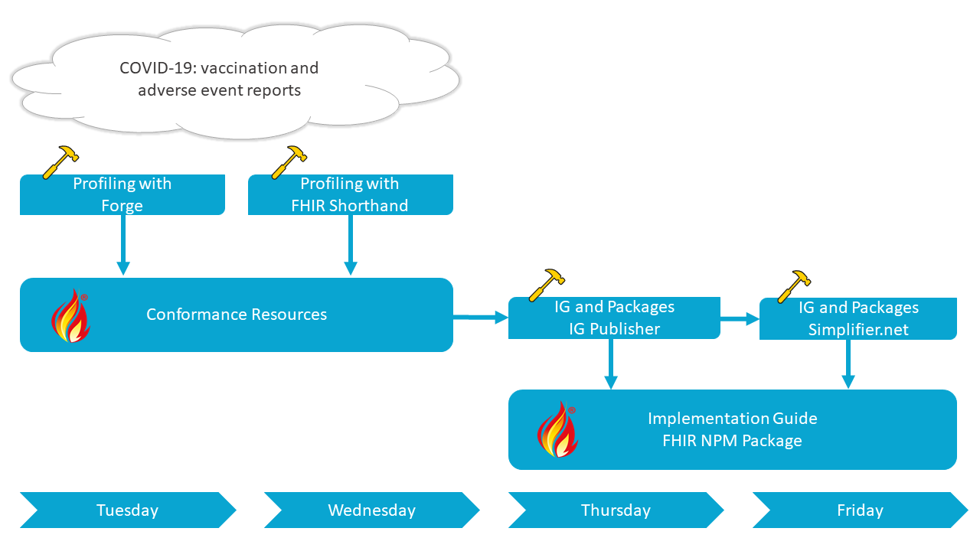
Profiling Tutorials and Let's Build Sequence
https://www.devdays.com/november-2020/lets-build-a-fhir-specification/

Slide 4
Learning Objectives Tutorial/Let’s Build
Learn:
The purpose of FHIR Shorthand
How it compares to other methods of creating Implementation Guides
Basic grammar
Build:
Your first profile in FHIR Shorthand
Use SUSHI, the FHIR Shorthand compiler
Notes:
When writing learning objectives, we suggest that the initial word of each learning objective be a verb as shown on the http://ccc.clinton.edu/CurriculumCommittee/ListofMeasurableVerbs.cxml web page. Please ensure your learning objectives are located at multiple/different 'levels' (see https://teaching.uncc.edu/services-programs/teaching-guides/course-design/blooms-educational-objectives for additional details).

Slide 5
What is FHIR Shorthand (FSH)?
A language for profiling and implementation guide (IG) creation
Part of the FHIR family of standards, currently Standard for Trial Use (STU 1)
Seamlessly integrated with the HL7 FHIR IG Publisher
Open source and free to use

Slide 6

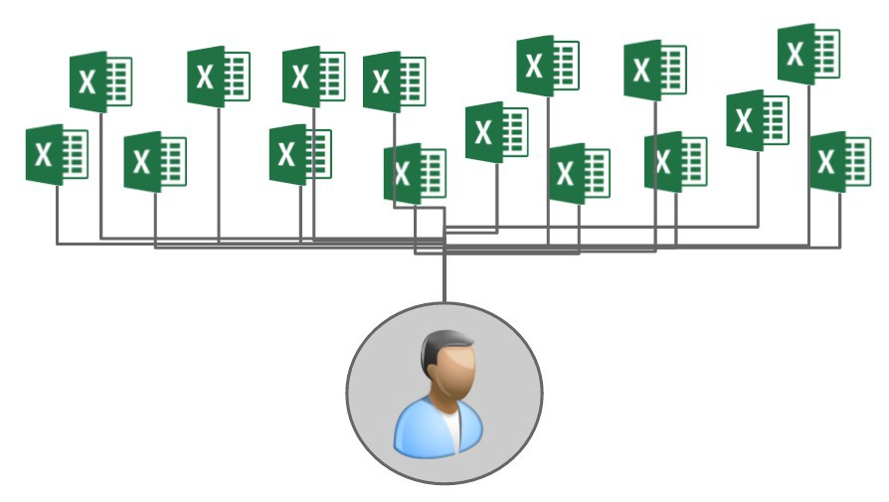




Profiling Approaches
Spreadsheet
Point-and-Click
Command
phasing out

Slide 7
The FSH Family of Tools
FSH Language Specification -- HL7 FHIR Standard
School of FSH -- web site with documentation, tools, examples
FSH On line -- interactive FHIR Shorthand
Go FSH -- convert existing implementation guides into FSH (beta)
SUSHI Init -- instantly set up a new project
VS Code extension -- code highlighter for VS Code editor
SUSHI -- compile FSH into FHIR Artifacts
FSH Finder -- web crawler to find FSH projects

Slide 8
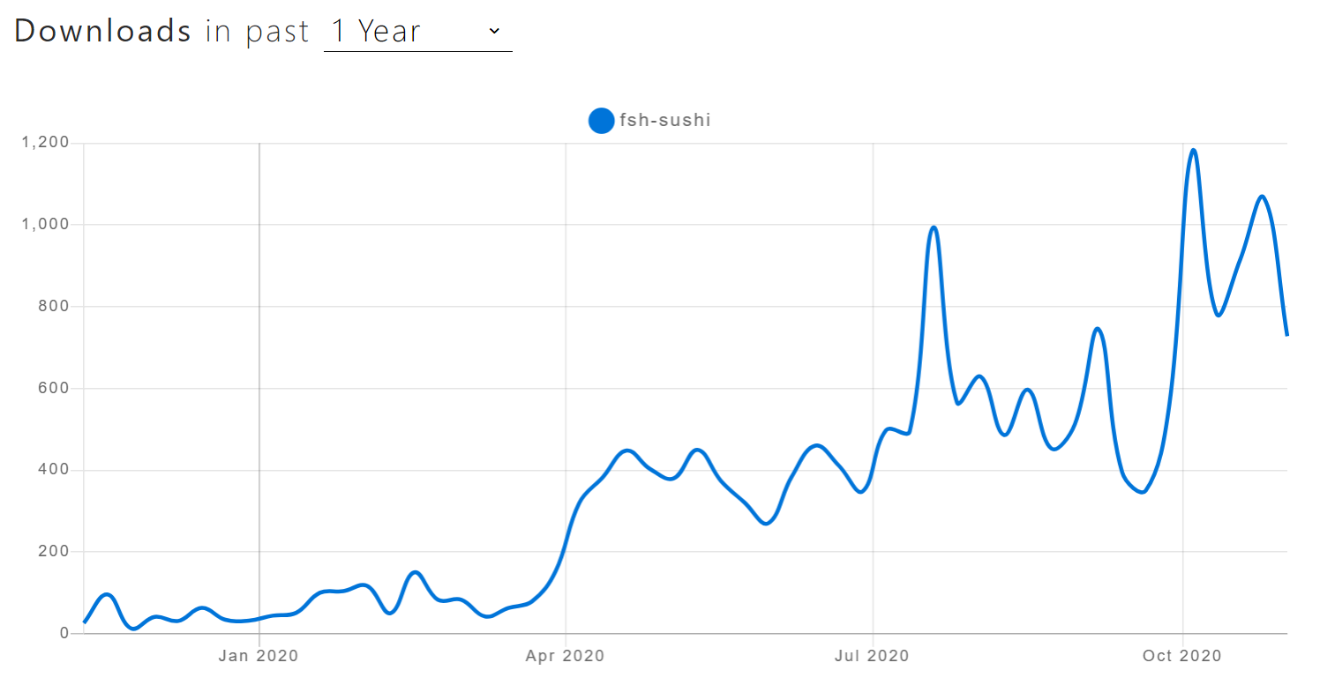
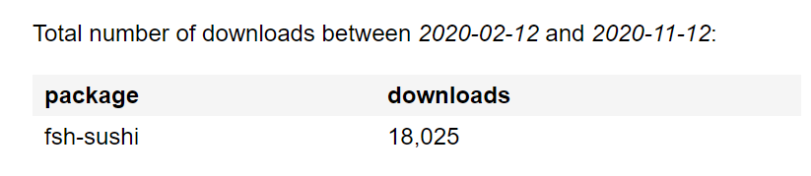

FSH Consumption is Rising

Slide 9

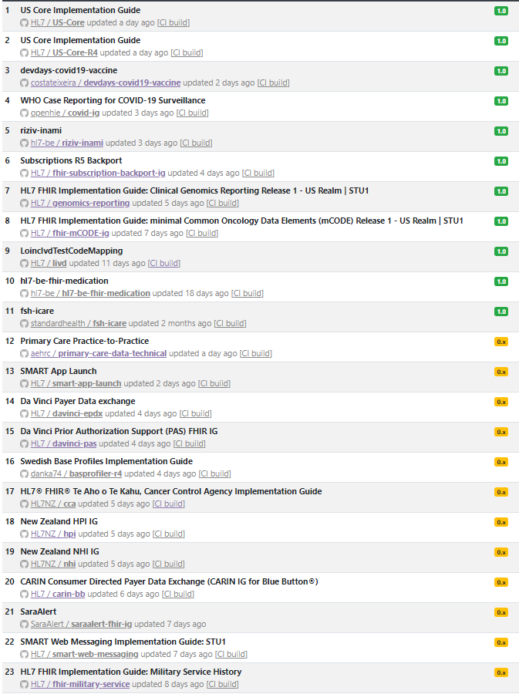
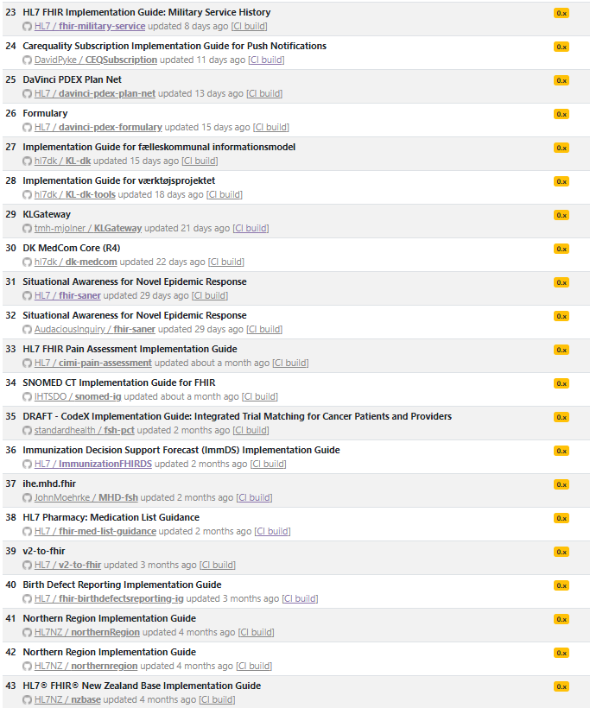
https://fshschool.org/fsh-finder/

Slide 10

“ ”
The ability to create implementation guides, value sets, code systems, and any sample resource you might ever want in this simple language is simply fantastic.
“ ”
FSH has legs
“ ”
FSH is a joy!
Grahame Grieve
FHIR Product Director
David Hay,
ClinFHIR, blogger
Keith Boone,
Audacious Inquiry
“ ”
I have to admit "Go FSH" fills me with joy - whatever it is the app does
“ ”
An immensely useful project
Lloyd McKenzie,
HL7 Canada
Richard Kavanagh, Board Member HL7 UK

Slide 11
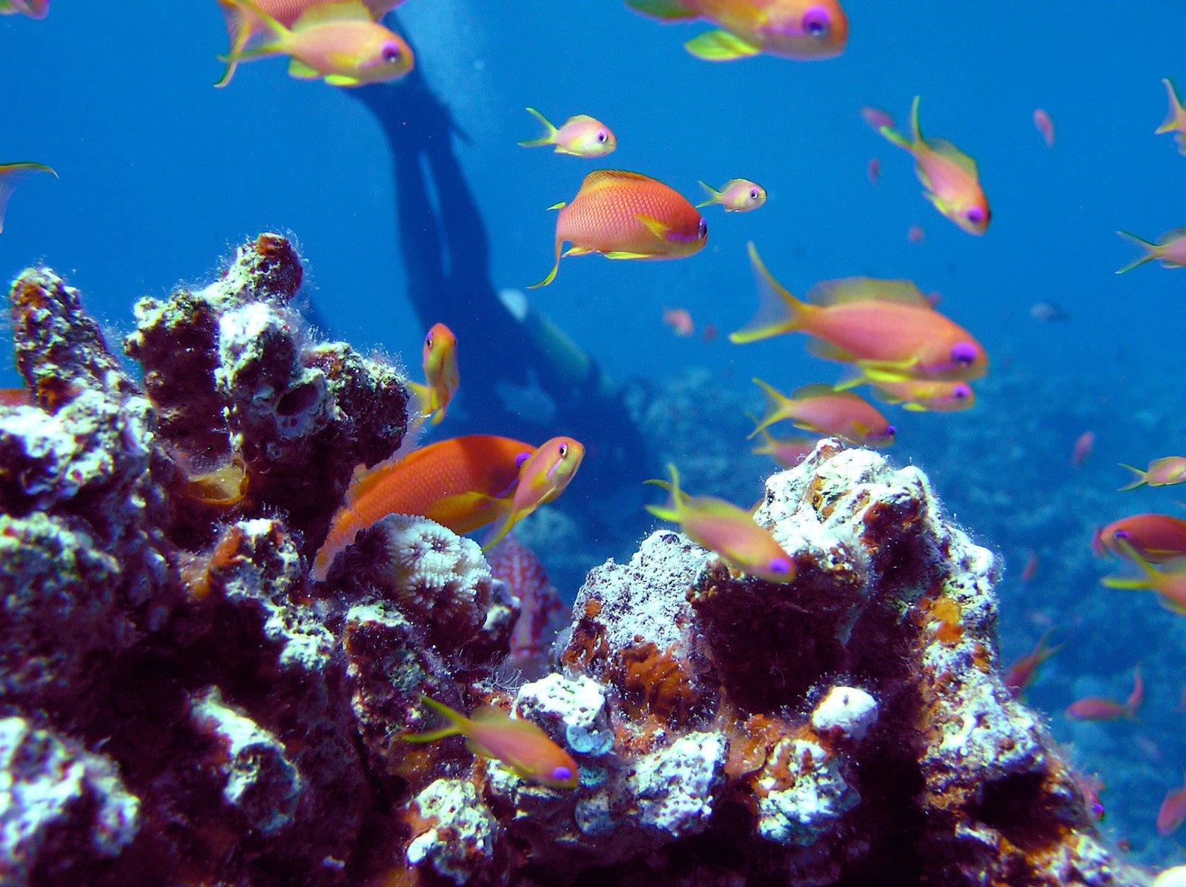
Let's Dive into FSH
https://www.freeimages.com/photo/diver-1381076

Slide 12
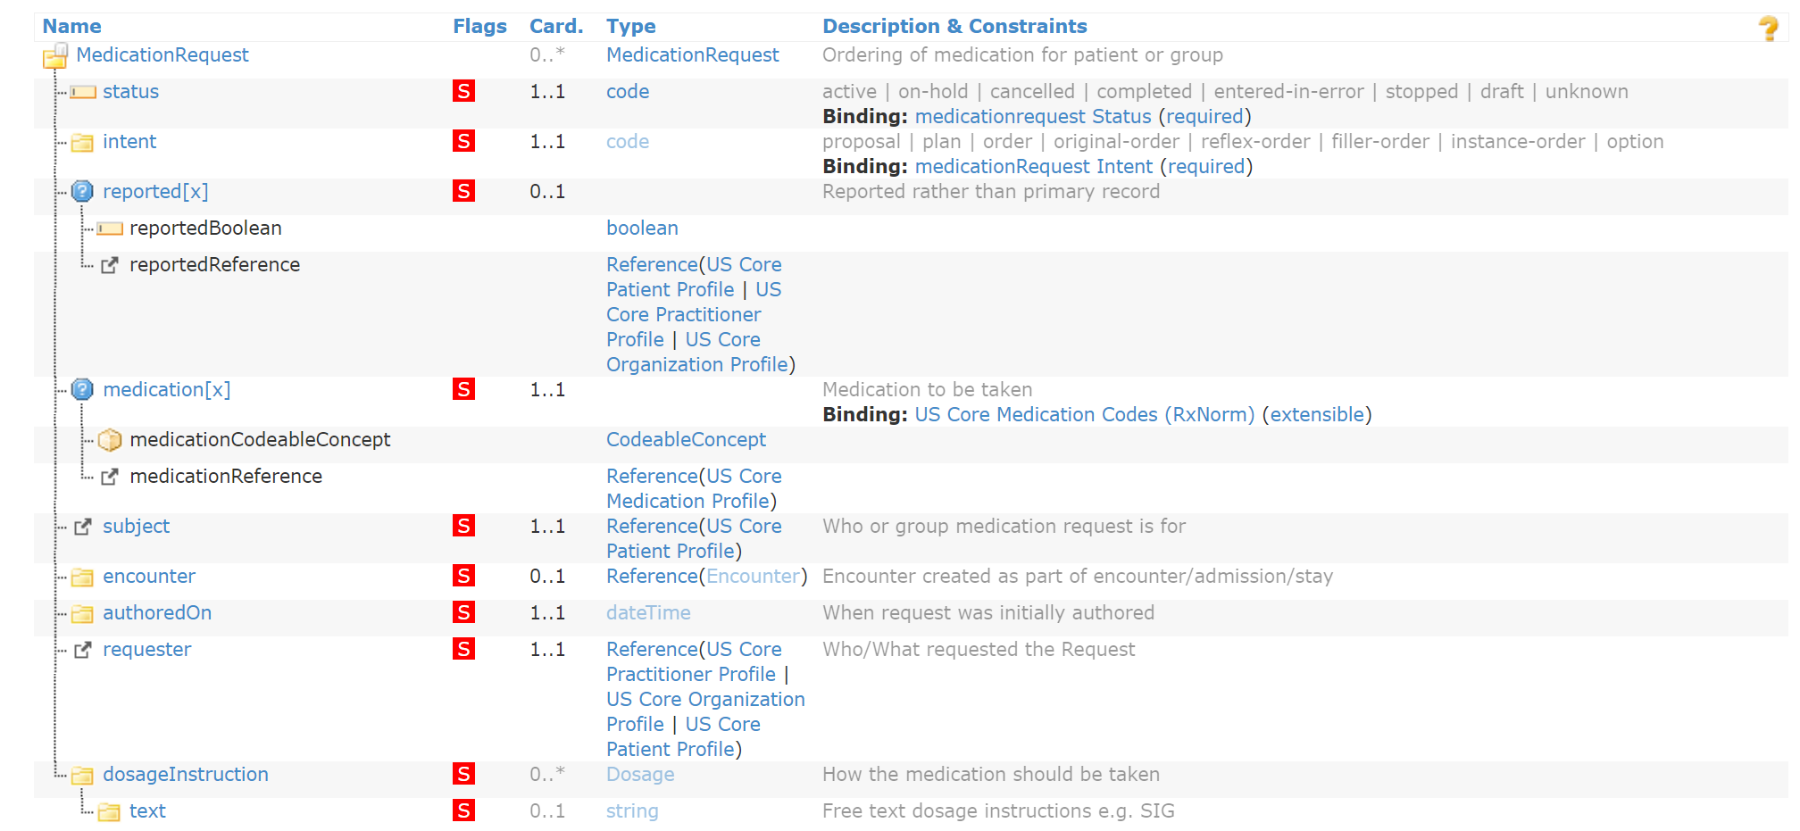
Typical profile:
Must support
Cardinality
Data type
Value Set Binding

Slide 13


Text Editor for .fsh Files
Any text editor will do, but we suggest Visual Studio Code (https://code.visualstudio.com/download)
Load any .fsh file, and VS Code will prompt to install the extension:

Slide 14
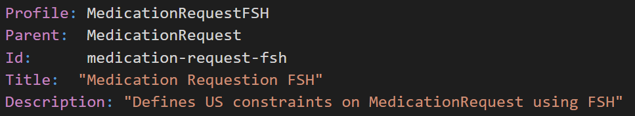
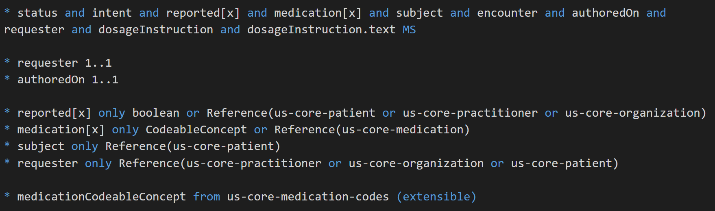
Declaration and Keywords
MustSupport
and Cardinality
Rules
Data Type Choices
Value Set Binding

Slide 15
Anatomy of a FSH Item:
CodeSystem:
Extension:
Instance:
Invariant:
Mapping:
Profile:
RuleSet:
ValueSet:
Declaration:
Description:
Id:
InstanceOf:
Parent:
Title:
Usage:
Keywords:
* Rules
Assignment
Binding
Cardinality
Contains
Flag
Insert
Obeys
Type

Slide 16
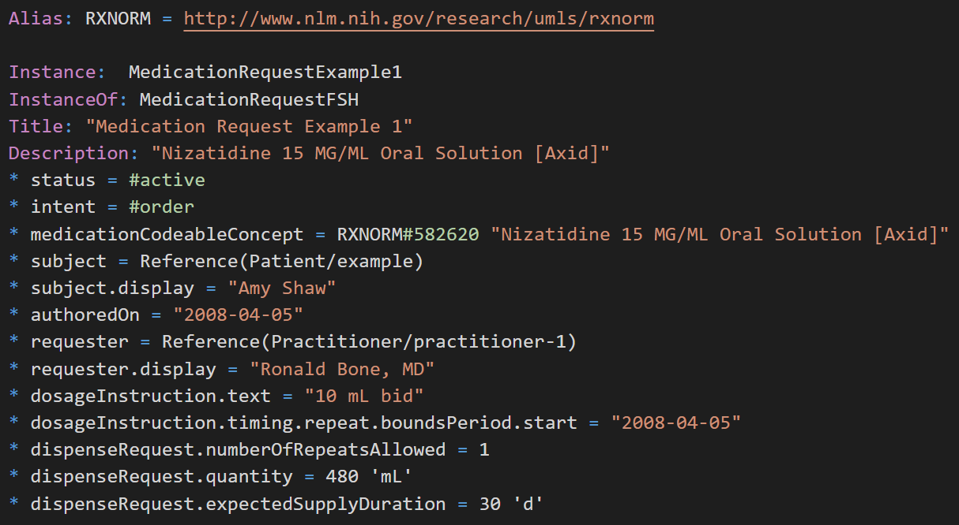
Add an Instance (Example):
Global Alias
Declaration and Keywords
code
CodeableConcept
Reference
Rules
Nested path
Quantity

Slide 17
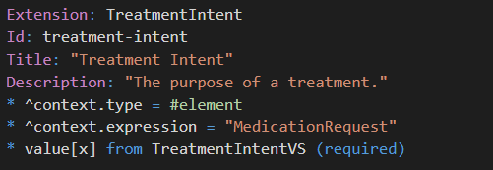
Define an Extension
Declaration and Keywords
Metadata (caret rule)
Rules
Add it to profile with "extension contains" rule:

Slide 18
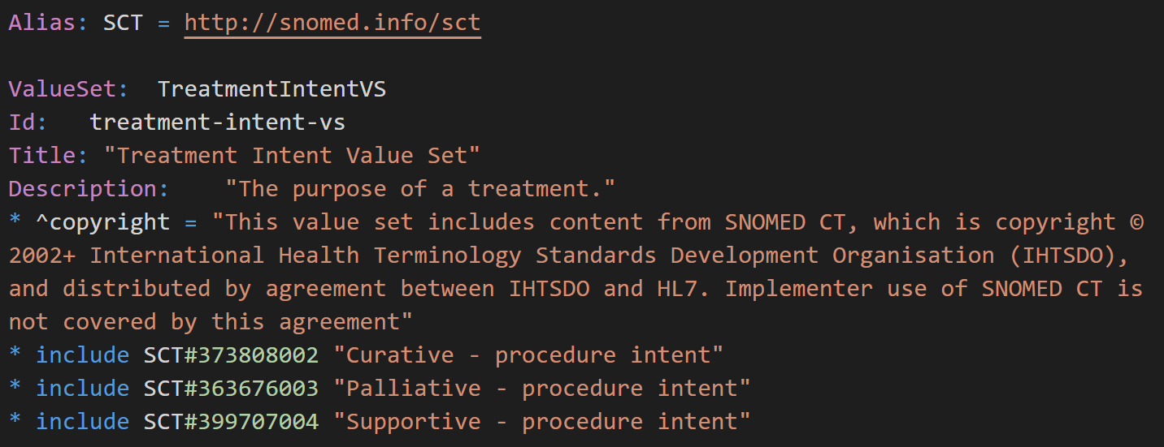
Define the TreatmentIntentVS value set:
Declaration and Keywords
Rules
Include a single code in VS

Slide 19
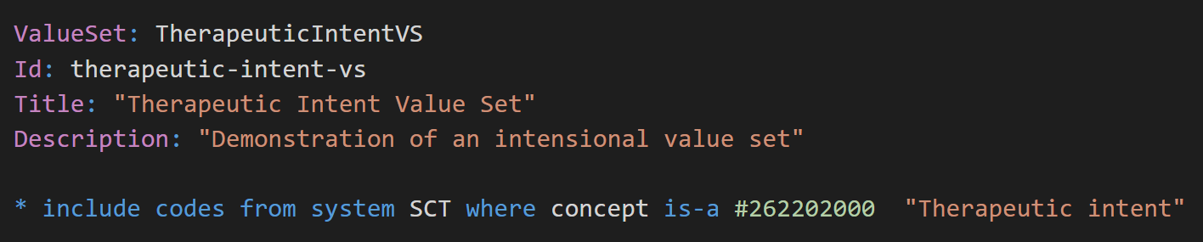
Intensional definition of a Value Set:

Slide 20
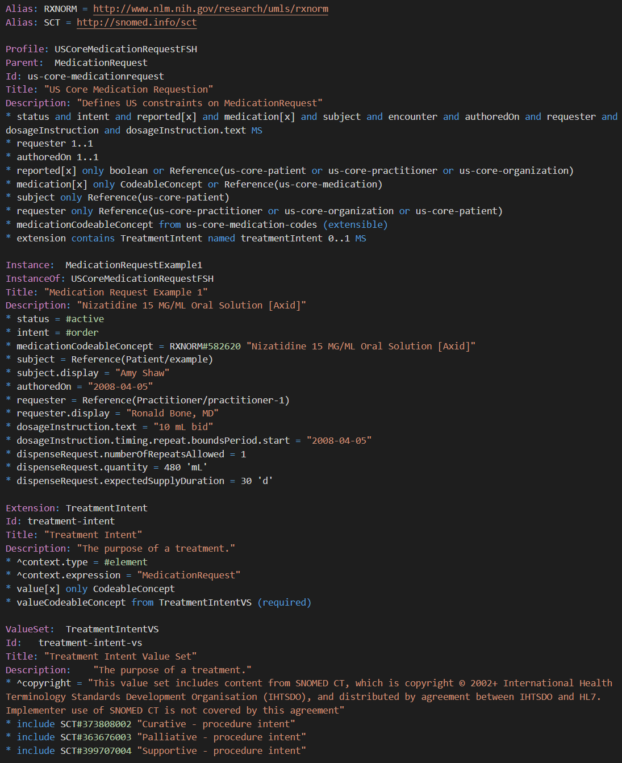
One .fsh file - but can be split up arbitrarily
48 lines of FSH =
1 Profile
1 Instance
1 Extension
1 Value set
FSH file(s) can be put under source code control in Github (branched, merged, full version management)

Slide 21
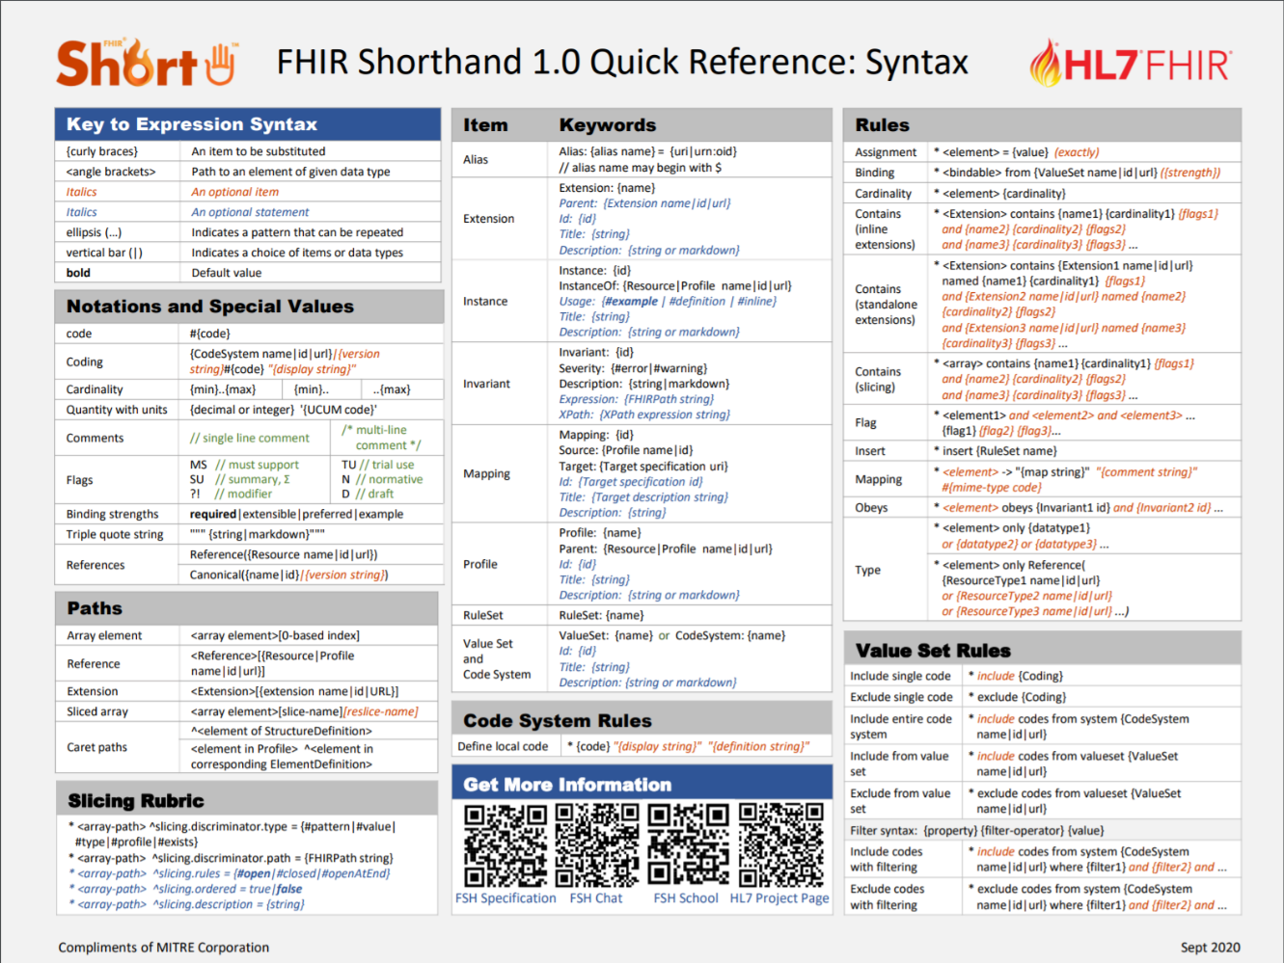
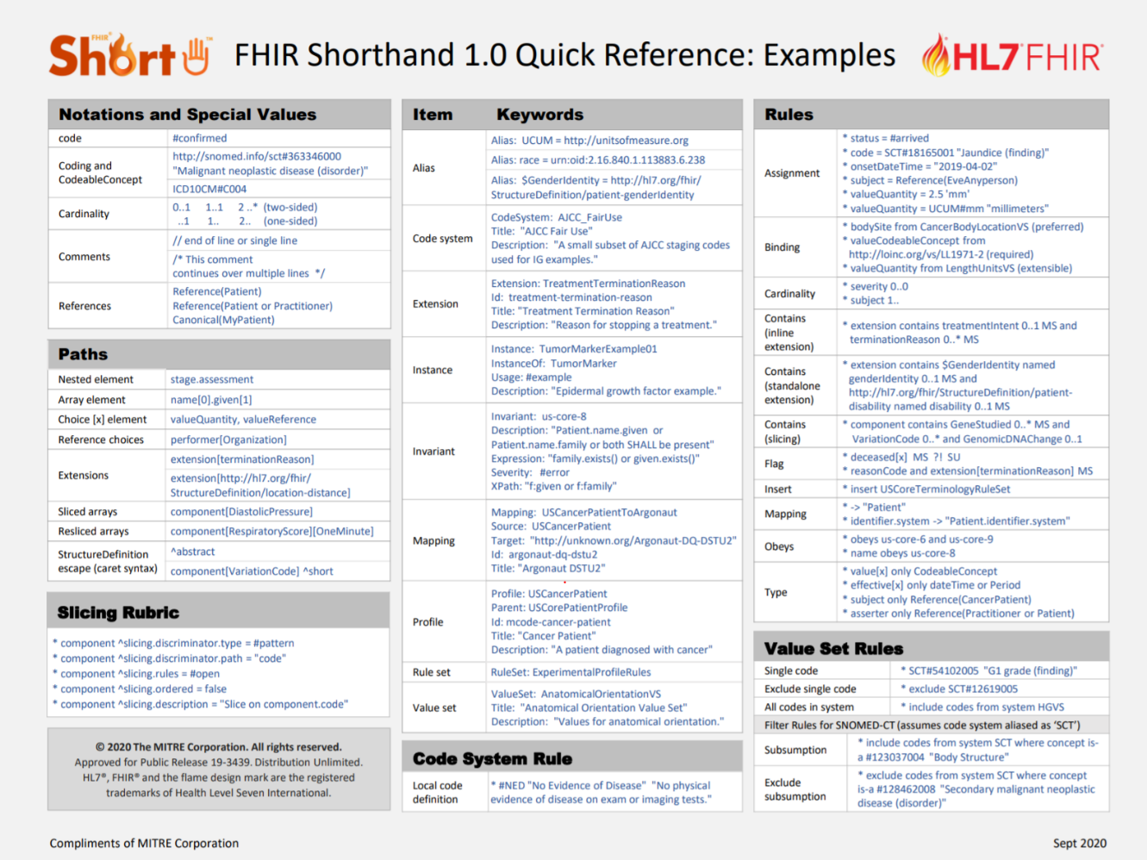
Quick Reference Card
Syntax
Examples
http://hl7.org/fhir/uv/shorthand/FSHQuickReference.pdf

Slide 22
Directory Structure
normal IG project structure
IG project structure + FSH
IG-root
├── ig.ini
├── input
│ ├── ignoreWarnings.txt
│ ├── images
│ │ ├── myDocument.pdf
│ │ ├── myGraphic.png
│ │ └── mySpreadsheet.xlsx
│ ├── includes
│ │ └── menu.xml
│ ├── resources
│ │ └── myOtherResources.json
│ └── pagecontent
│ ├── 1_mySecondPage.md
│ ├── 2_myThirdPage.md
│ ├── 3_myFourthPage.md
│ └── index.md
├── package-list.json
└── input-cache/publisher.jar
IG-root
├── ig.ini
├── sushi-config.yaml
├── input
| ├── fsh
| | ├── file1.fsh
| | ├── file2.fsh
| | └── file3.fsh
│ ├── ignoreWarnings.txt
│ ├── images
│ │ ├── myDocument.pdf
│ │ ├── myGraphic.png
│ │ └── mySpreadsheet.xlsx
│ ├── includes
│ │ └── menu.xml
│ ├── resources
│ │ └── myOtherResources.json
│ └── pagecontent
│ ├── 1_mySecondPage.md
│ ├── 2_myThirdPage.md
│ ├── 3_myFourthPage.md
│ └── index.md
├── package-list.json
└── input-cache/publisher.jar
+ FSH

Slide 23
Configuration File: sushi-config.yaml
Include in top level project directory:
id: fhir.example
canonical: http://hl7.org/fhir/example
name: ExampleIG
title: "Example IG Version 0.1.0"
description: "An example IG that demonstrates FSH grammar"
status: draft
license: CC0-1.0
version: 0.1.0
fhirVersion: 4.0.1
copyrightYear: 2020+
releaseLabel: ci-build
dependencies:
hl7.fhir.us.core: 3.1.0
See https://fshschool.org/docs/sushi/configuration/

Slide 24
Running SUSHI from the Command Line
First install SUSHI: npm install -g fsh-sushi
See https://fshschool.org/docs/sushi/installation/ for more information
Open a command window
Navigate to the project root directory
type sushi at the prompt

Slide 25
normal IG project structure + FSH
IG-root
├── ig.ini
├── sushi-config.yaml
├── input
| ├── fsh
| | ├── file1.fsh
| | ├── file2.fsh
| | └── file3.fsh
│ ├── ignoreWarnings.txt
│ ├── images
│ │ ├── myDocument.pdf
│ │ ├── myGraphic.png
│ │ └── mySpreadsheet.xlsx
│ ├── includes
│ │ └── menu.xml
│ ├── resources
│ │ └── myOtherResources.json
│ └── pagecontent
│ ├── 1_mySecondPage.md
│ ├── 2_myThirdPage.md
│ ├── 3_myFourthPage.md
│ └── index.md
├── package-list.json
└── input-cache/publisher.jar
New folder with generated FHIR artifacts
IG-root
├── fsh-generated
| └── resources
| ├── CodeSystem-myCodeSystem.json
| ├── Patient-myPatient-example.json
| ├── StructureDefinition-myExtension.json
| ├── StructureDefinition-myProfile.json
| ├── ValueSet-myValueSet.json
| └── ImplementationGuide-myIG.json
├── ig.ini
├── sushi-config.yaml
├── input
| ├── fsh
etc.
run SUSHI

Slide 26
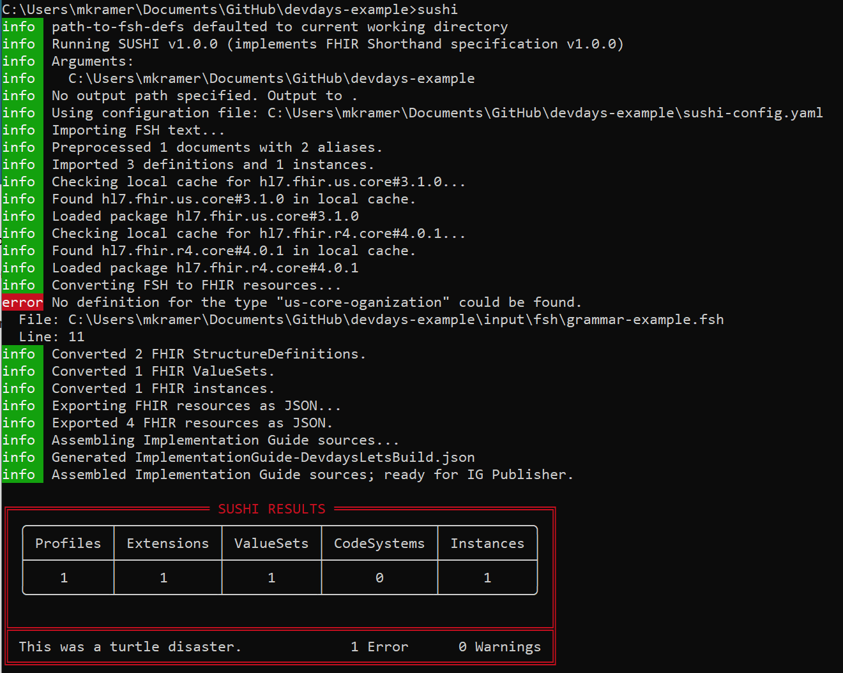
SUSHI Command Window Output
Error messages give a file number and line number

Slide 27
Running the IG Publisher (IGP)
If you don't have them, obtain the scripts _genonce and _updatePublisher from the sample-ig project (https://github.com/FHIR/sample-ig/archive/master.zip) and copy them to your root directory
See https://fshschool.org/docs/sushi/running/#downloading-the-ig-publisher-scripts
Open a command window
Run _updatePublisher
Run _genonce
SUSHI will run automatically if the ./input/fsh directory is found

Slide 28

Directory Structure
normal IG project structure + FSH
IG-root
├── ig.ini
├── sushi-config.yaml
├── input
| ├── fsh
| | ├── file1.fsh
| | ├── file2.fsh
| | └── file3.fsh
│ ├── ignoreWarnings.txt
│ ├── images
│ │ ├── myDocument.pdf
│ │ ├── myGraphic.png
│ │ └── mySpreadsheet.xlsx
│ ├── includes
│ │ └── menu.xml
│ ├── resources
│ │ └── myOtherResources.json
│ └── pagecontent
│ ├── 1_mySecondPage.md
│ ├── 2_myThirdPage.md
│ ├── 3_myFourthPage.md
│ └── index.md
├── package-list.json
└── input-cache/publisher.jar
run IG publisher (runs SUSHI automatically)
IG-root
├── fsh-generated
├── output
├── temp
├── template
IG home page

Slide 29
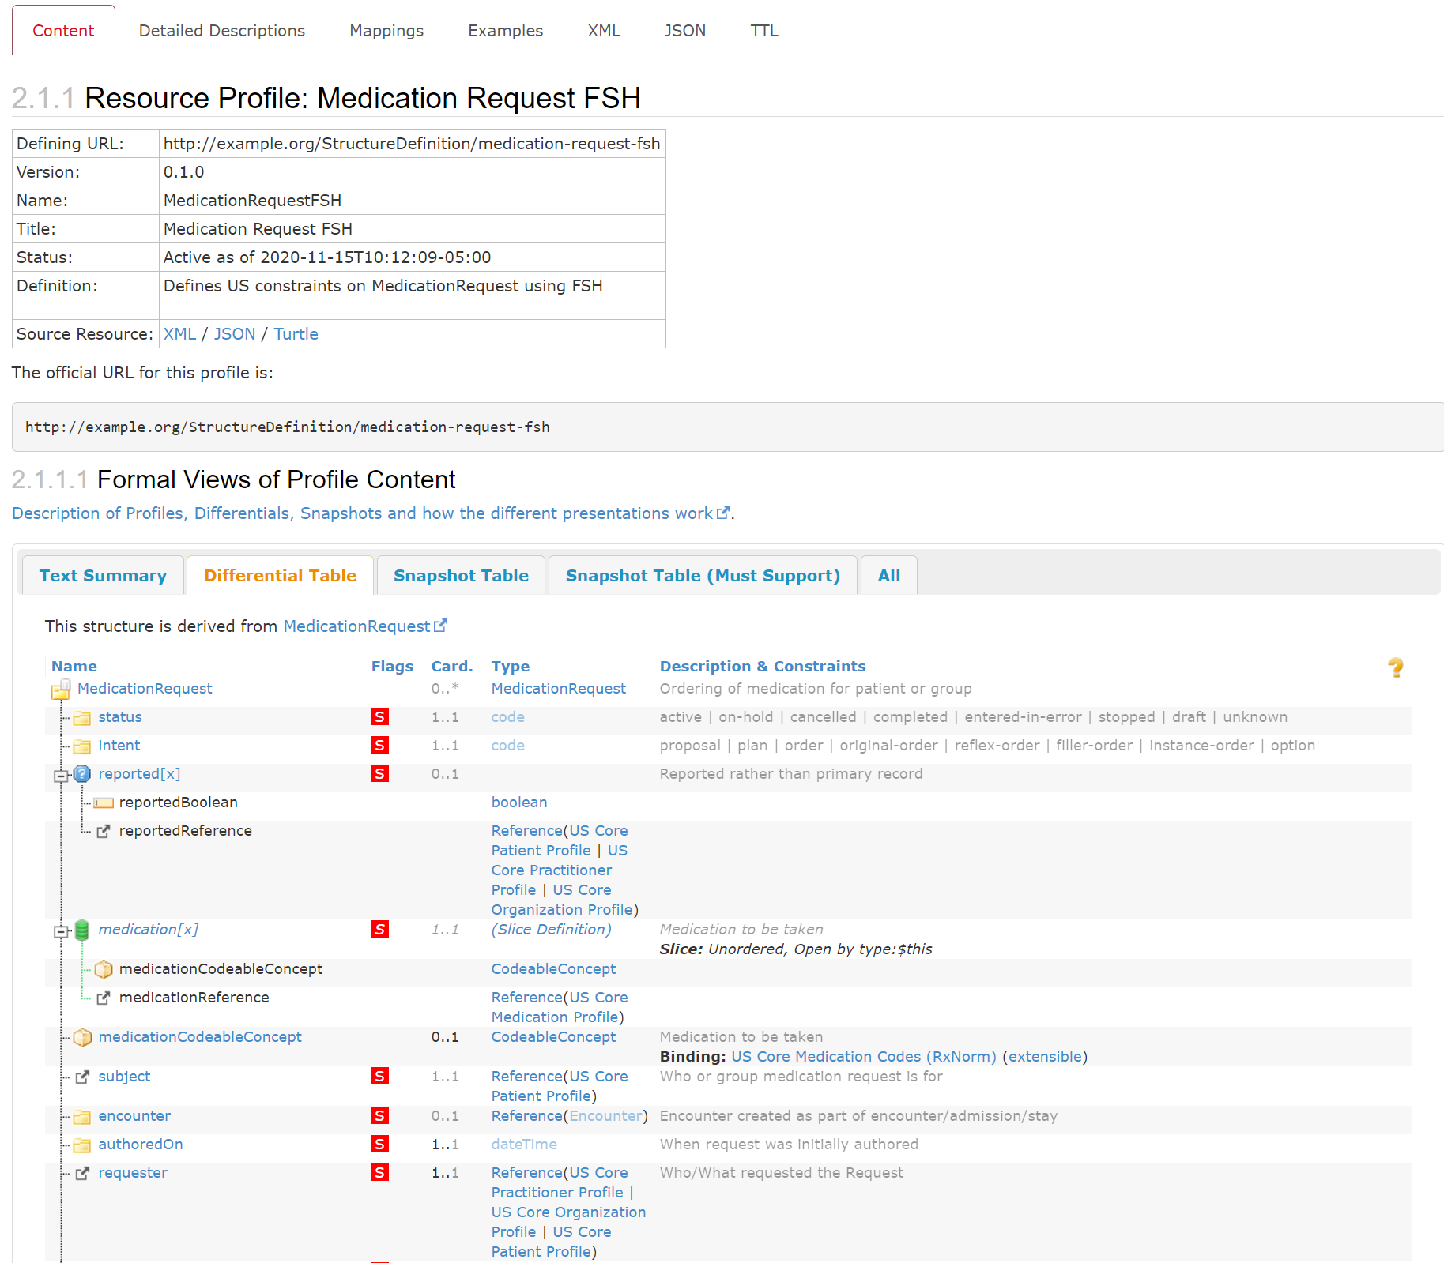
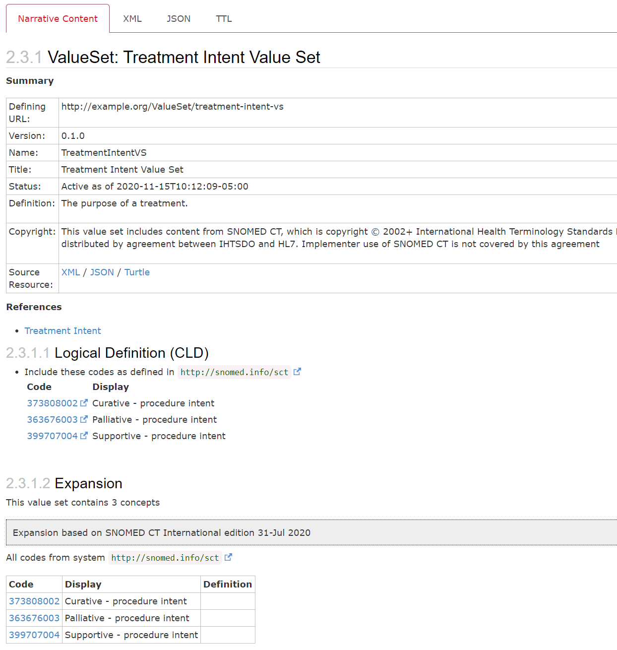
The Resulting IG
48 lines of FSH:
1 Profile
1 Instance
1 Extension
1 Value set

Slide 30
That's great, Mark, but I already have an IG...

Slide 31

Using GoFSH to Convert an Existing IG (beta)
First install gofsh: npm install -g gofsh
Navigate to the directory above where the StructureDefinitions are located
At the command prompt, type: gofsh
Results will be appear in /gofsh subdirectory
https://www.clipartmax.com/middle/m2i8H7N4Z5A0Z5b1_betta-002-royalty-free/

Slide 32
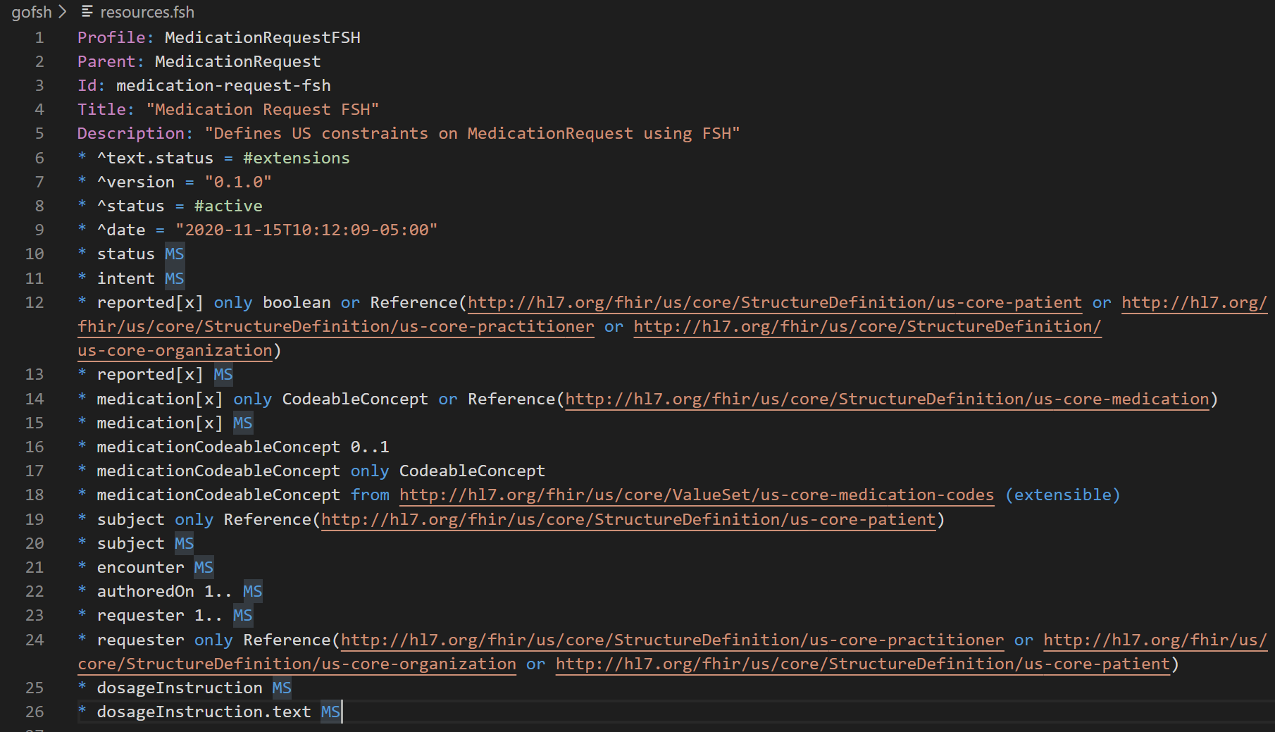
Sample GoFSH output
How does it compare to our hand-rolled FSH?

Slide 33
Review: What did you learn?
The purpose of FHIR Shorthand
How it compares to other methods of creating Implementation Guides
Some FSH grammar
Creating an IG
Next: Let's Build
Create your first FHIR Shorthand project
Hands-on with SUSHI, the FHIR Shorthand compiler

Slide 34
Contact
During DevDays, you can find / reach me here:
Via Whova App – Speaker’s Gallery
# shorthand channel on chat.fhir.org
email: mkramer@mitre.org

